Slide 1
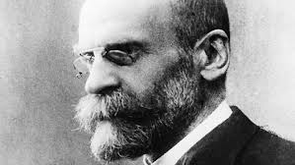

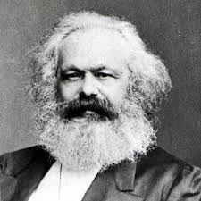
Sociological Theories
A sociological theory is simply a way of explaining society and human behaviour.
Different groups of sociologists have different ideas about how society works.

Slide 2
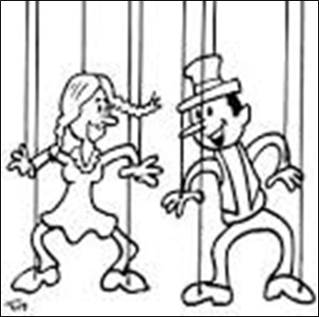

Sociological Theories
STRUCTURALIST
SOCIAL ACTION
Macro approach (large scale) – focuses on the structure of society
Focuses on how society shapes human behaviour.
Behaviour is determined by external forces beyond individual control.
People are puppets on a string, manipulated by society.
We behave according to the norms and values we internalise during socialisation.
Micro approach (small scale) – focuses on small scale interaction (Interactionists)
Individuals have free will and have the power to shape society.
Focuses on interaction between ‘social actors’.
The strings are broken – we determine our behaviour and society

Slide 3
Sociological Theories
STRUCTURALIST
CONSENSUS
CONFLICT
FUNCTIONALISTS

Slide 4
Sociological Theories
STRUCTURALIST
CONSENSUS
CONFLICT
FUNCTIONALISTS
Consensus means agreement.
There is harmony in society.
There is agreement on shared norms and values (value consensus)
Very positive – all the institutions are FUNCTIONAL for the smooth running of society.
Institutions are working together so society is working at its most effective.
There is social solidarity (a sense of unity / belonging to the group)
There is social order.

Slide 5

Sociological Theories
STRUCTURALIST
The Organic Analogy
CONSENSUS
FUNCTIONALISTS
Consensus means agreement.
The is harmony in society.
There is agreement on shared norms and values (value consensus)
Very positive – all the institutions are FUNCTIONAL for the smooth running of society.
Institutions are working together so society is working at its most effective.
There is social order.

Slide 6
Sociological Theories
STRUCTURALIST
CONSENSUS
The Organic Analogy
Functionalists liken society to the body. The human organs are like the social institutions.
The are all functional.
They work together.
They are interdependent if one fails the others will fail.
The institutions need to be in equilibrium (balance with one another)
FUNCTIONALISTS
Consensus means agreement.
The is harmony in society.
There is agreement on shared norms and values (value consensus)
Very positive – all the institutions are FUNCTIONAL for the smooth running of society.
Institutions are working together so society is working at its most effective.
There is social order.

Slide 7

Sociological Theories
STRUCTURALIST
CONFLICT
CONSENSUS
Marxists
Society is based on conflict not consensus.
Social class is the main division in society.
Our values are determined by one dominating group – the rich (Bourgeoisie). There is not value consensus, instead the poor (Proletariat) are brainwashed into accepting the norms and values of the Bourgeoisie (Bourgeoisie ideology)
FUNCTIONALISTS
Consensus means agreement.
The is harmony in society.
There is agreement on shared norms and values (value consensus)
Very positive – all the institutions are FUNCTIONAL for the smooth running of society.
Institutions are working together so society is working at its most effective.
There is social order.

Slide 8

Sociological Theories
STRUCTURALIST
CONSENSUS
CONFLICT
FUNCTIONALISTS
Consensus means agreement.
The is harmony in society.
There is agreement on shared norms and values (value consensus)
Very positive – all the institutions are FUNCTIONAL for the smooth running of society.
Institutions are working together so society is working at its most effective.
There is social order.
Feminists
Gender is the most important division in society.
Society is patriarchal (male dominated).
Women are exploited and oppressed at the hands of men.

